Slide 1


Brazilian E-Commerce Public Dataset by Olist
ITP.SO.23.R3.Power Bi

Slide 2
Team
Abdullah
Hani
Asala Mostafa
Ayah Allah Alaa
Elham Saied
Mostafa Yousry
Mohamed Ayman

Slide 3

Business Intelligence is about providing the right data at the right time to the right people so that they can take the right decisions.
Nicolas Babin, Founder and CEO of Babin Business Consulting

Slide 4
Agenda
Introduction
Business Requirements
Aim of the Project
Database Description
Methodology
Data Preparation
Data Warehousing
Data Visualization (Power BI + Tableau)
Reporting Data (SSRS)
Conclusion and Recommendations

Slide 5
Introduction

Slide 6


Introduction
E-commerce has become an integral part of modern business, offering customers the convenience of shopping online from anywhere at any time.
The growth of e-commerce has created new opportunities for businesses of all sizes to reach a wider audience and expand their market share.
Olist is a Brazilian e-commerce platform that connects sellers to various marketplaces, allowing them to sell their products to customers all over Brazil.
With over 8,000 sellers and 20 marketplaces, Olist has become a key player in the Brazilian e-commerce industry, helping businesses to grow and thrive in the digital marketplace.
This presentation will provide an overview of a business intelligence project on the Olist database, highlighting the importance of data-driven decision-making in the e-commerce industry.

Slide 7
Business Requirements

Slide 8
Business Requirements
Requirements
Stakeholders
Limitations
Gain insight into customer behaviour and preferences to improve product offerings and increase sales.
Identify trends and patterns in sales data to optimize supply chain management and inventory levels.
Monitor and analyse seller performance to ensure quality and consistency of service.
Develop a centralized data repository for reporting and analysis to improve decision-making across the organization.
Business owners and managers who need to make data-driven decisions to improve business operations and increase profitability.
Sales and marketing teams who need to understand customer behaviour and preferences to develop effective marketing strategies.
Supply chain and logistics teams who need to optimize inventory levels and manage the supply chain to meet customer demand.
IT teams who need to develop and maintain the data infrastructure to support reporting and analysis.
Limited project timeline due to business needs and resource availability.
Limited availability of data due to data privacy and security concerns.

Slide 9
Aim of the Project

Slide 10

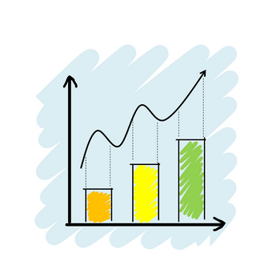
Aim of the Project
Develop a comprehensive business intelligence solution that meets the business requirements and stakeholder needs.
Provide actionable insights and recommendations to improve business operations and increase profitability.
Develop a scalable and sustainable data infrastructure to support future business intelligence needs.

Slide 11
Database Description

Slide 12


Database Description
The Olist database is a relational database that contains information about sales transactions, customer and seller profiles, product information, and order fulfilment.
The database is comprised of several tables, including:
Customers: Contains information about customer profiles, including name, address, and contact information.
Sellers: Contains information about seller profiles, including name, address, and contact information.
Products: Contains information about the products sold on Olist, including product name, description, and category.
Orders: Contains information about each sales transaction, including order ID, customer ID, seller ID, and order details.
Reviews: Contains information about customer reviews of products and sellers.
The challenges of working with the Olist database include:
Data quality issues, such as missing or incomplete data.
Data integration issues, such as inconsistencies between data sources.
Data privacy and security concerns, such as protecting customer and seller information.

Slide 13
Methodology

Slide 14
Methodology Process
Data Extraction
1
Data Cleaning and Preparation
2
Data Warehousing
3
Reporting with SSRS
6
Data Visualization with PowerBI
4
Data Visualization with Tableau
5
Source: Created by the team

Slide 15
Data Preparation

Slide 16
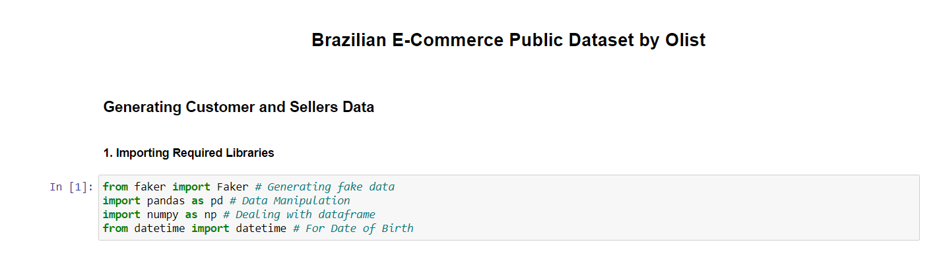
Data Preparation
Adding Customer and Seller Demographics (Age, Gender, Date of Birth, Full Name)
Source: Jupyter Notebook – Python by the team

Slide 17
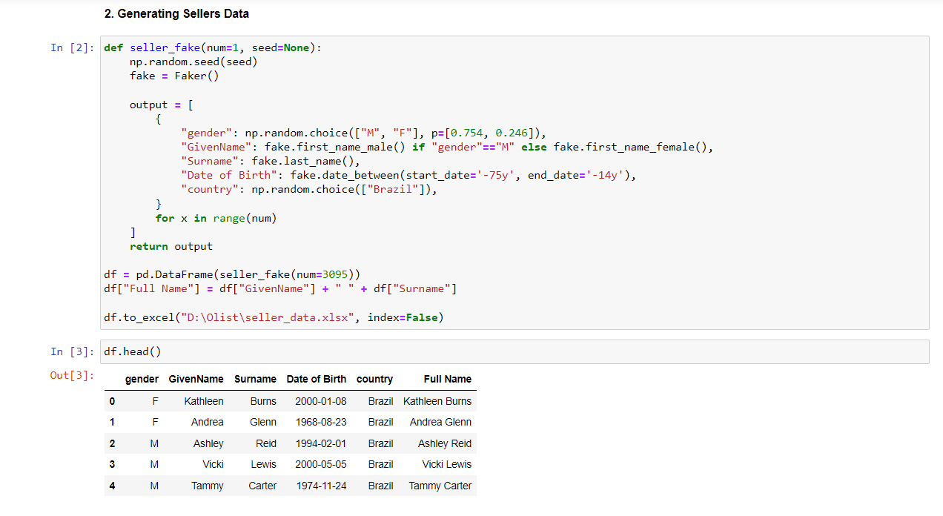
Data Preparation
Adding Customer and Seller Demographics (Age, Gender, Date of Birth, Full Name)
Source: Jupyter Notebook – Python by the team

Slide 18
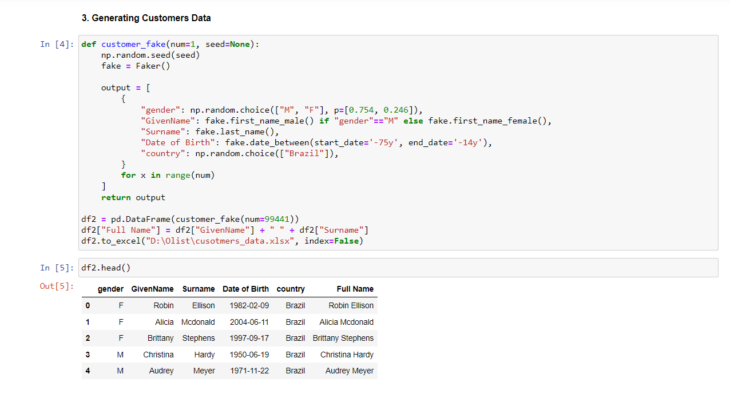
Data Preparation
Adding Customer and Seller Demographics (Age, Gender, Date of Birth, Full Name)
Source: Jupyter Notebook – Python by the team

Slide 19
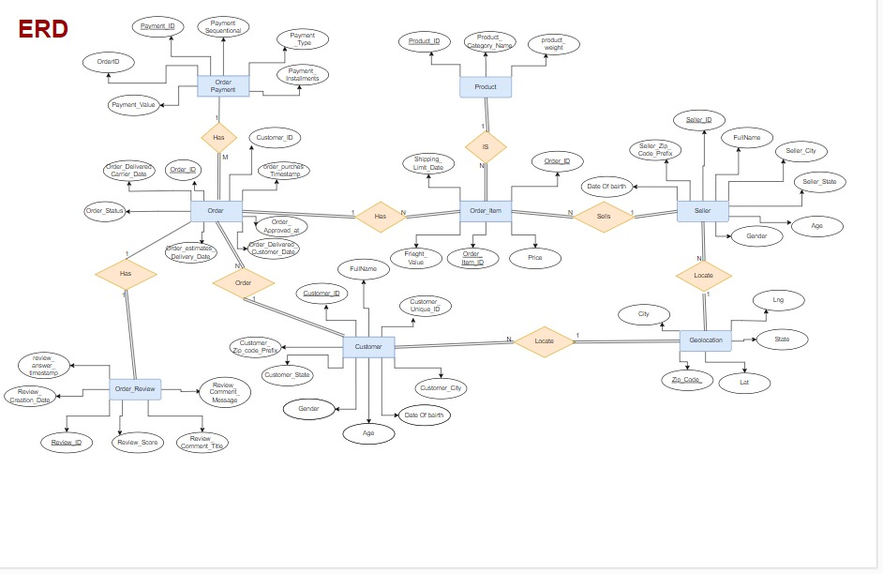
Database Description – ERD
Source: Draw.Io by the team

Slide 20
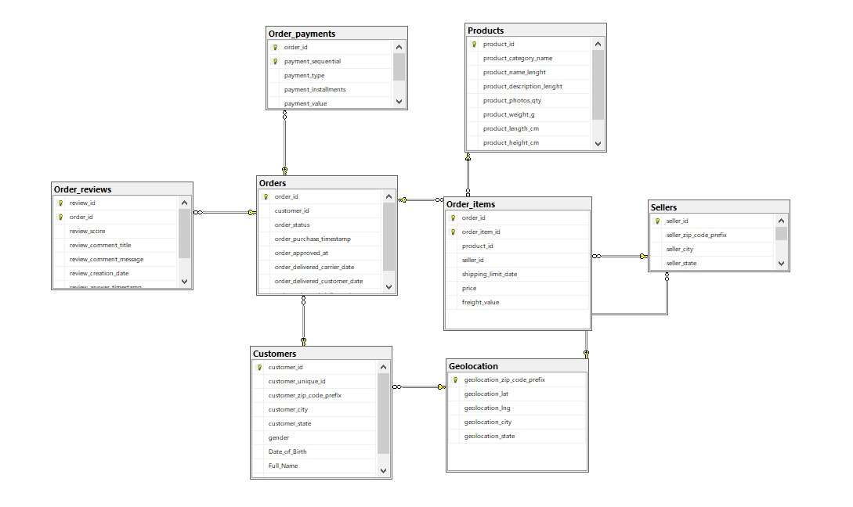
Database Description – OLTP
Source: SQL Server by the team

Slide 21
Data Warehousing

Slide 22
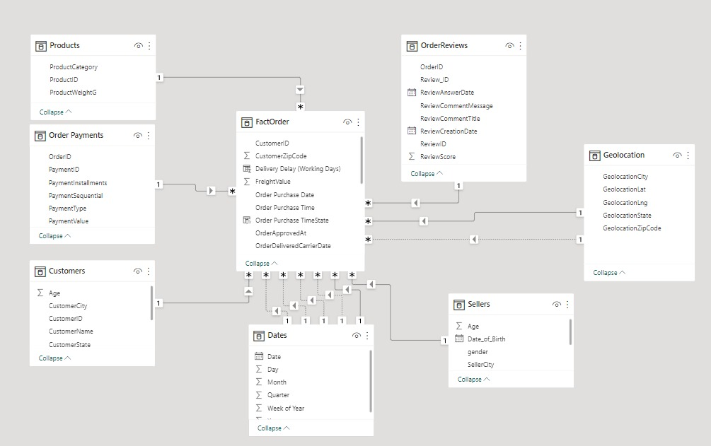
Data Warehouse – Star Schema
Source: Power BI by the team

Slide 23
Data Visualization
Power BI

Slide 24
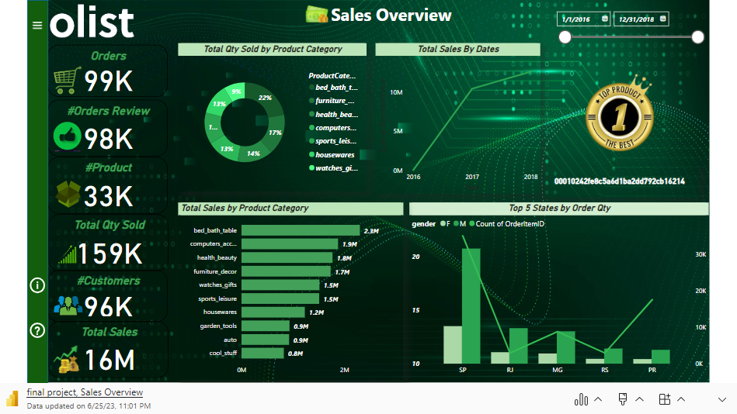
Data Visualization – Power BI
Source: Power BI Dashboard by the team

Slide 25
Data Visualization
Tableau

Slide 26
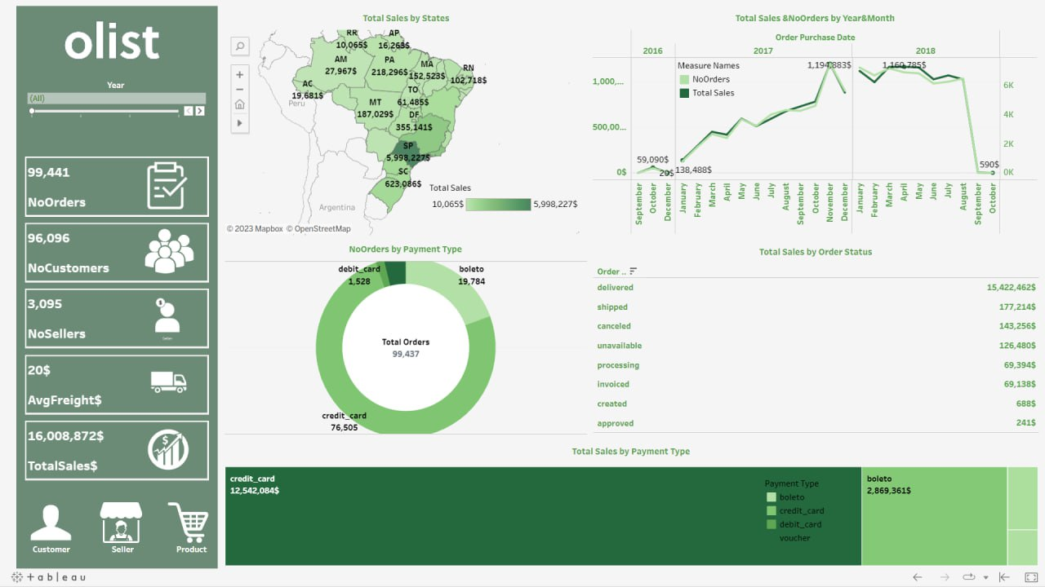
Data Visualization – Tableau
Source: Tableau by the team

Slide 27
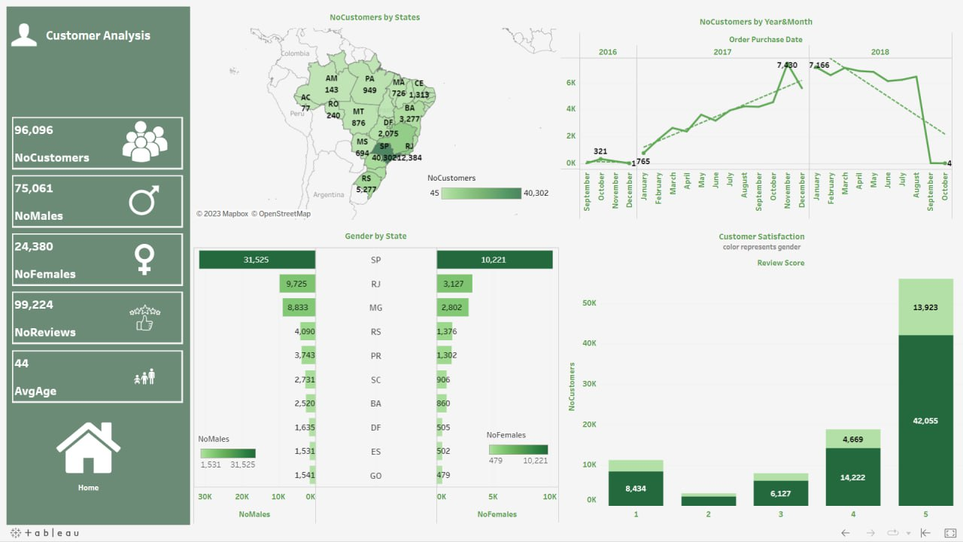
Data Visualization – Tableau
Source: Tableau by the team

Slide 28
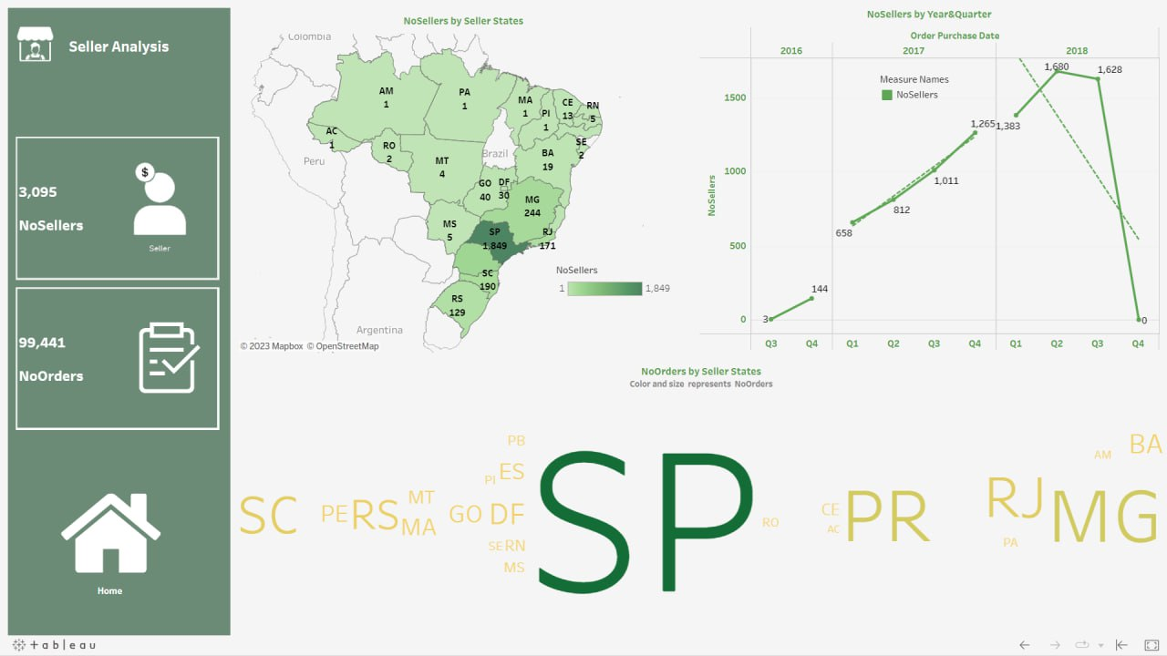
Data Visualization – Tableau
Source: Tableau by the team

Slide 29
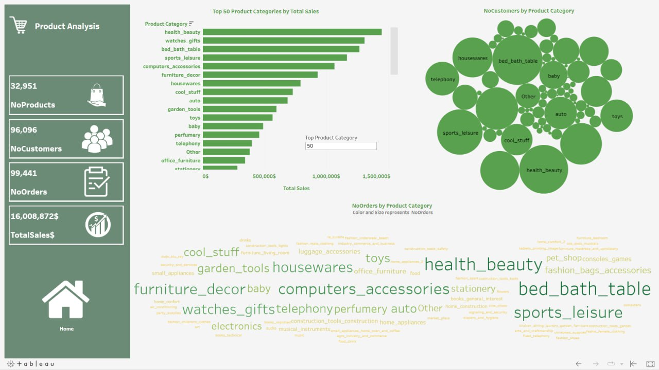
Data Visualization – Tableau
Source: Tableau by the team

Slide 30
Reporting Data SSRS

Slide 31
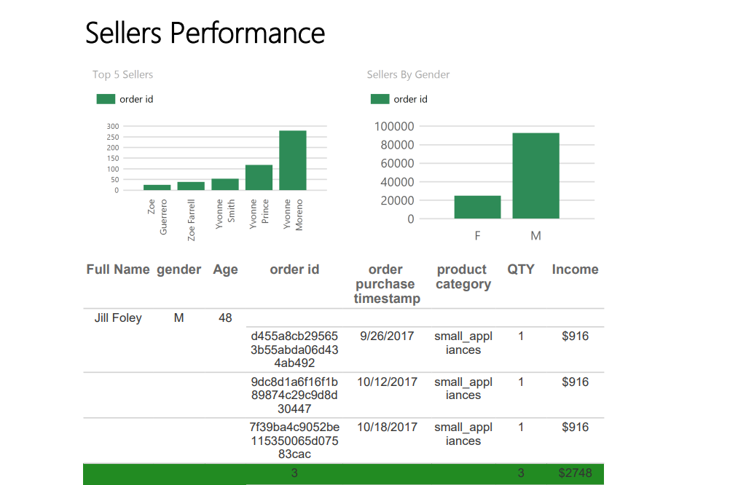
Reporting Data SSRS
Source: SSRS by the team

Slide 32
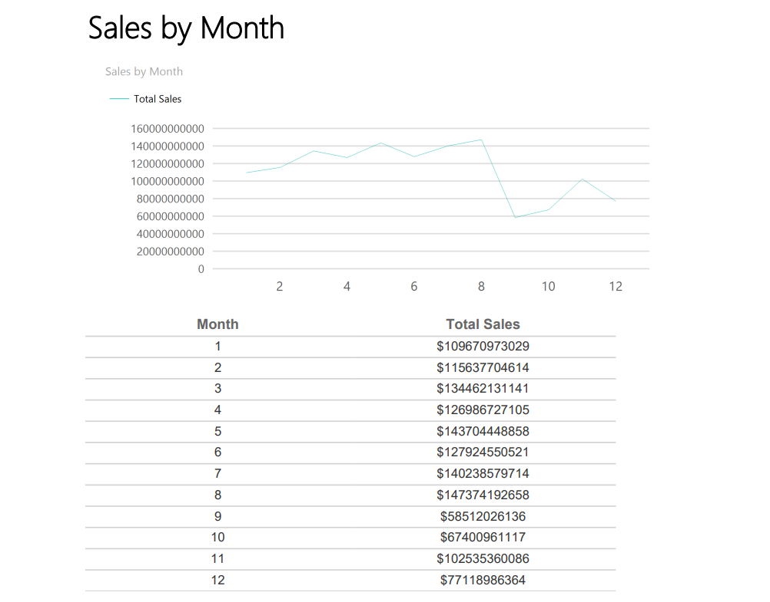
Reporting Data SSRS
Source: SSRS by the team

Slide 33
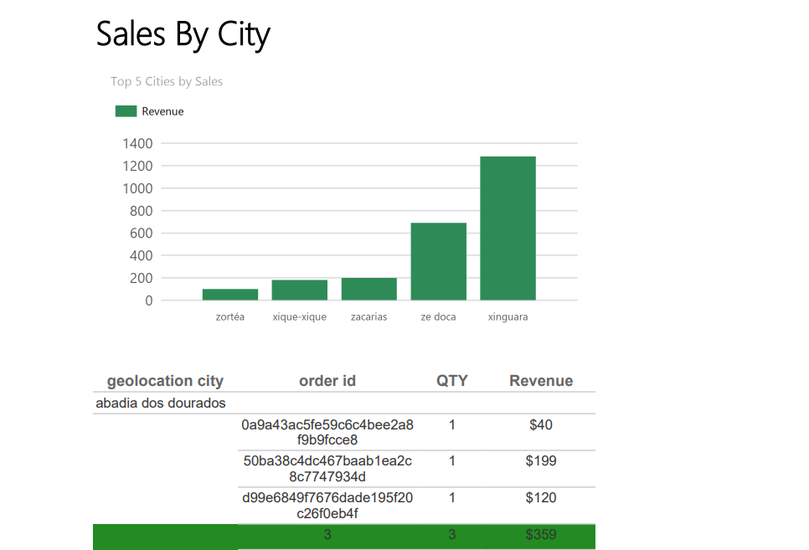
Reporting Data SSRS
Source: SSRS by the team

Slide 34
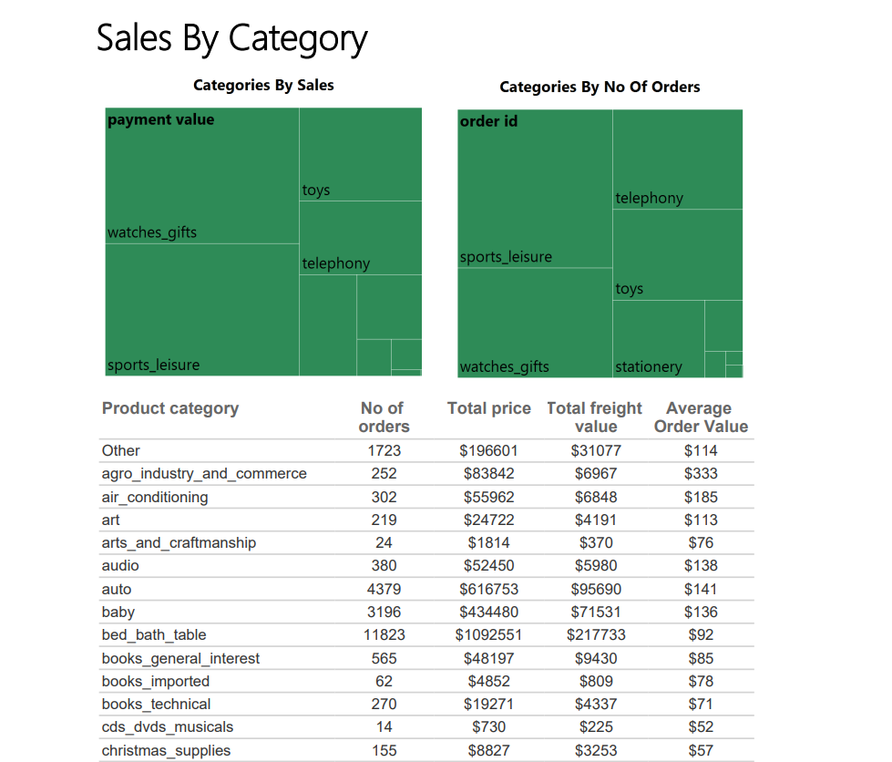
Reporting Data SSRS
Source: SSRS by the team

Slide 35
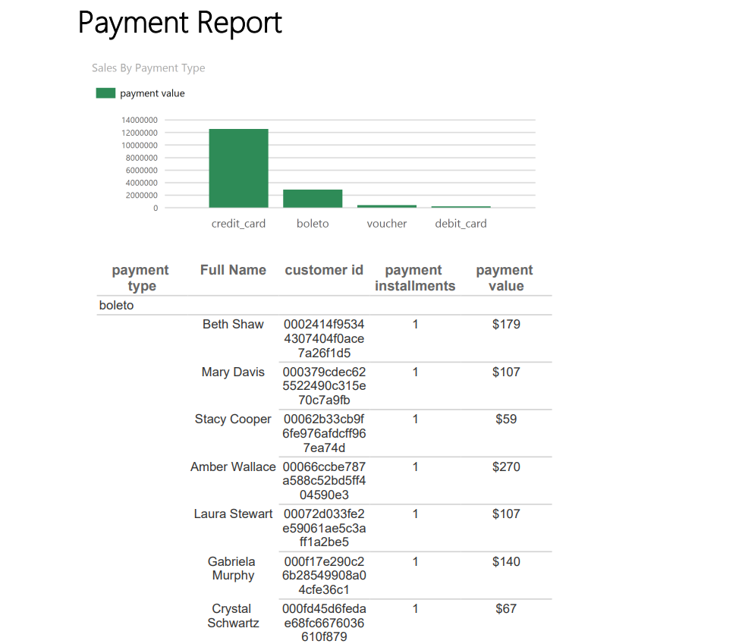
Reporting Data SSRS
Source: SSRS by the team

Slide 36
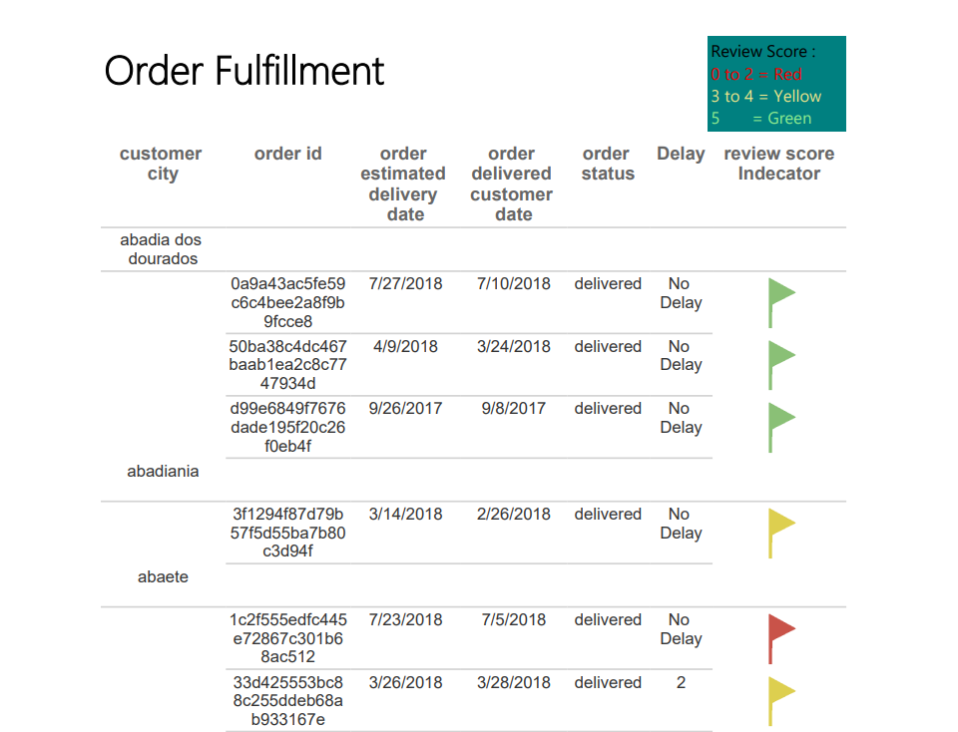
Reporting Data SSRS
Source: SSRS by the team

Slide 37
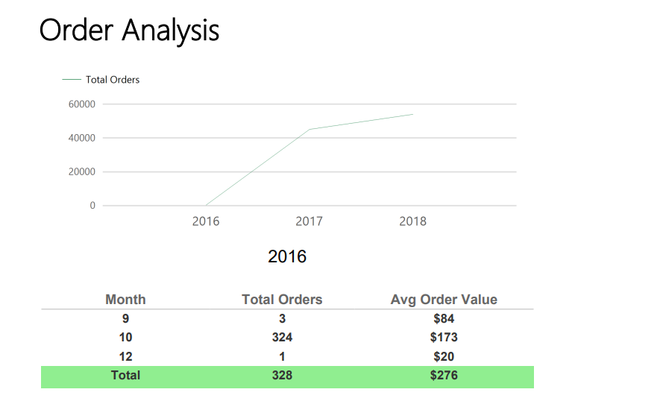
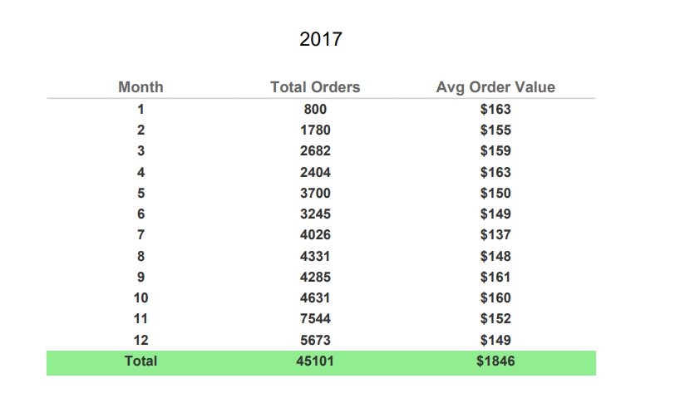
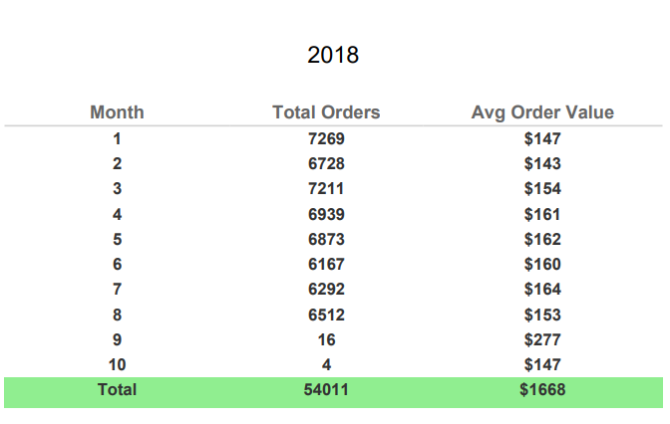
Reporting Data SSRS
Source: SSRS by the team

Slide 38
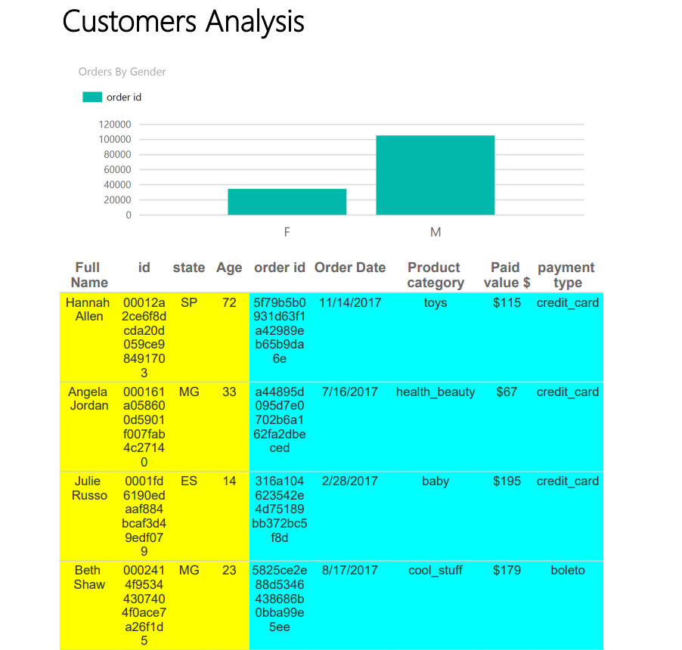
Reporting Data SSRS
Source: SSRS by the team

Slide 39
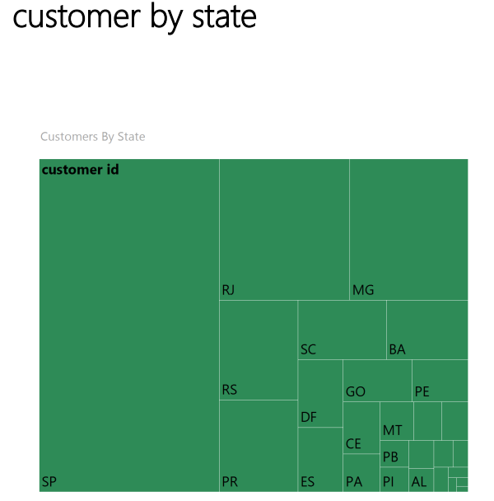
Reporting Data SSRS
Source: SSRS by the team

Slide 40
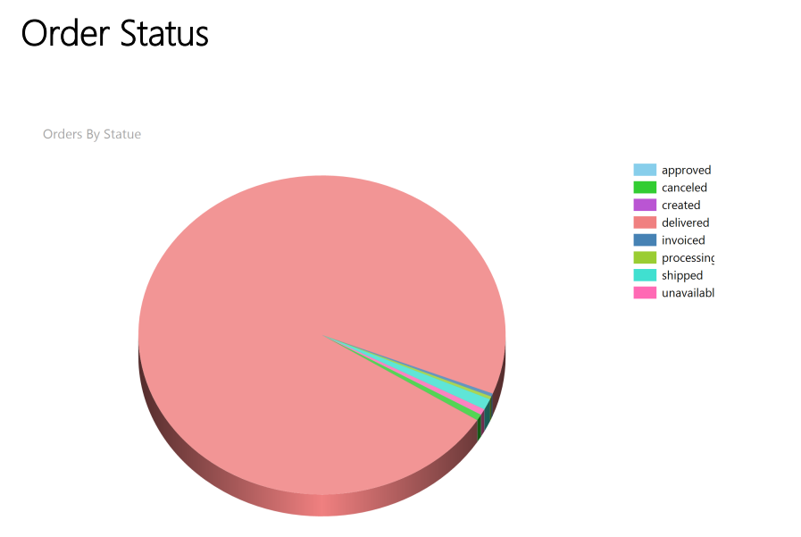
Reporting Data SSRS
Source: SSRS by the team

Slide 41


Summary
This presentation provided an overview of a BI project on the Olist database, highlighting the importance of data-driven decision-making in the e-commerce industry.
The project objectives were to develop a comprehensive BI solution that meets the business requirements and stakeholder needs, provide actionable insights and recommendations to improve business operations and increase profitability, and develop a scalable and sustainable data infrastructure to support future business intelligence needs.
The project methodology involved data extraction, cleaning, and preparation using SQL, data warehousing using an ETL process, and reporting and analysis using SSRS, Power BI, and Tableau.
The project deliverables included interactive dashboards and reports that provided insights into customer behaviour and preferences, seller performance, and product sales trends.
The project benefits included improved data quality and accuracy, a centralized data repository for reporting and analysis, and actionable insights and recommendations for business operations.

Slide 42
Thank you
Special Thanks to our Instructors for their usual support:
Ahmed Salah
Mahmoud Abd Elkhalek
Doaa Badawy
Mohamed Zannon
Abd El Wahed Ashraf
Abd El Rahman Sweeny
Salma M Saleh
Yahia

